Slide 1


Reading at Orrets Meadow
MF - 2/9/20

Slide 2
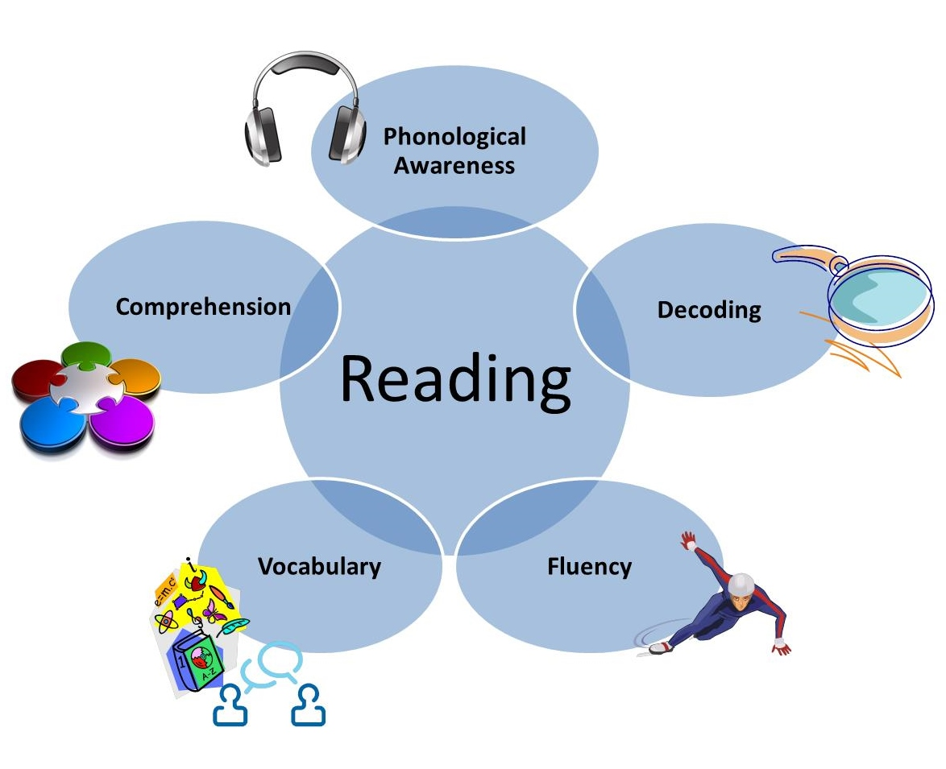
What skills are required to be an effective reader?

Slide 3
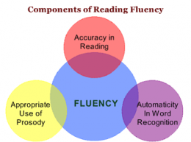
Reading Fluency

Slide 4

Reading Books at Orrets Meadow
4,458 individual titles!
5 Decades of publications
Over 30 different reading schemes

Slide 5

Why use book bands?
Clear levels of progression.
Determined by word level AND complexity of text.
Makes it easier to expose pupils to a range of text genres and formats.

Slide 6
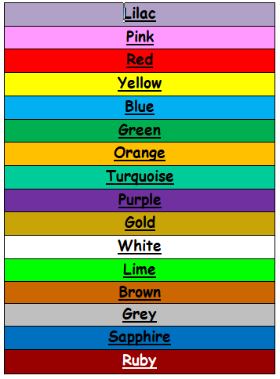
The Book Bands

Slide 7
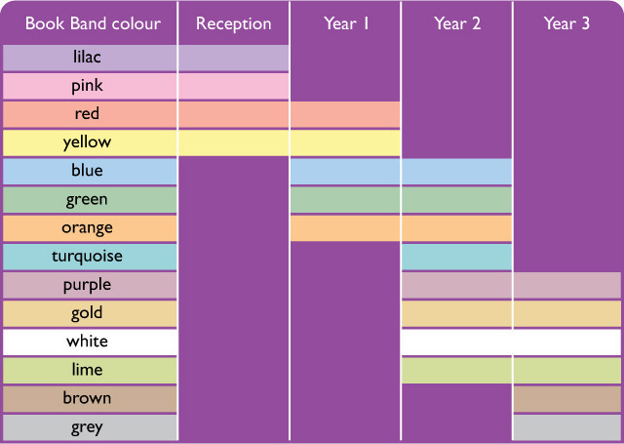

Slide 8
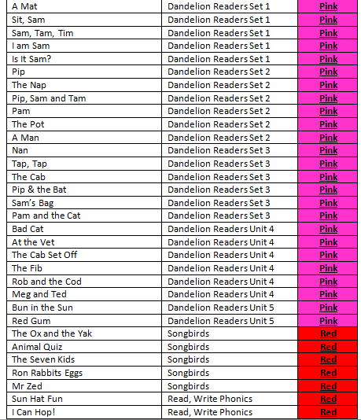
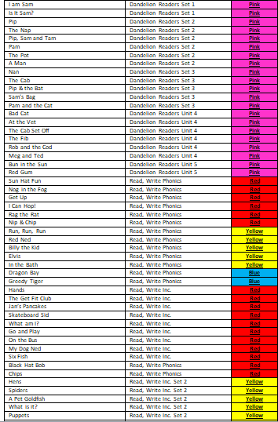
Each reading journey is different

Slide 9
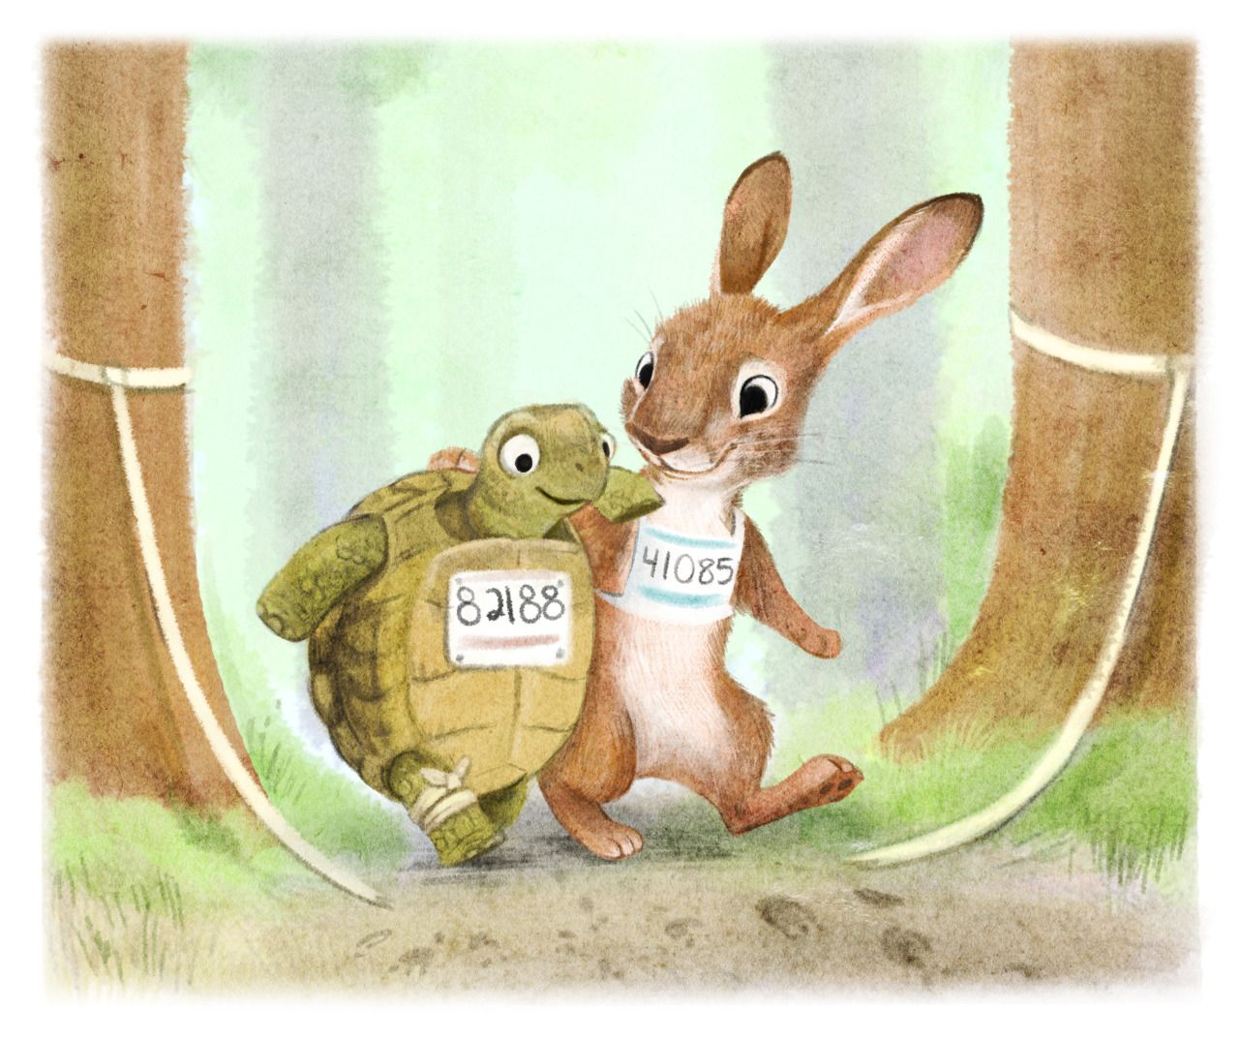
Remember it’s not a race!

Slide 10
Literacy Spine
Split into curriculum texts and class readers.
Books for different purposes - learning and pleasure.
Display your class reader on your classroom door.
Class readers to promote Prosody

Slide 11

Questions?

Slide 12
Where to find documents
Literacy Spine
Teachers – Curriculum – 1.2 English – English Documents – Literacy Spine
Book Band Flow
Teachers – Curriculum – 1.2 English – English Documents – Book Band Flow

