Slide 1
School Council
What have we done?

Slide 2
You asked and we got it!

Slide 3
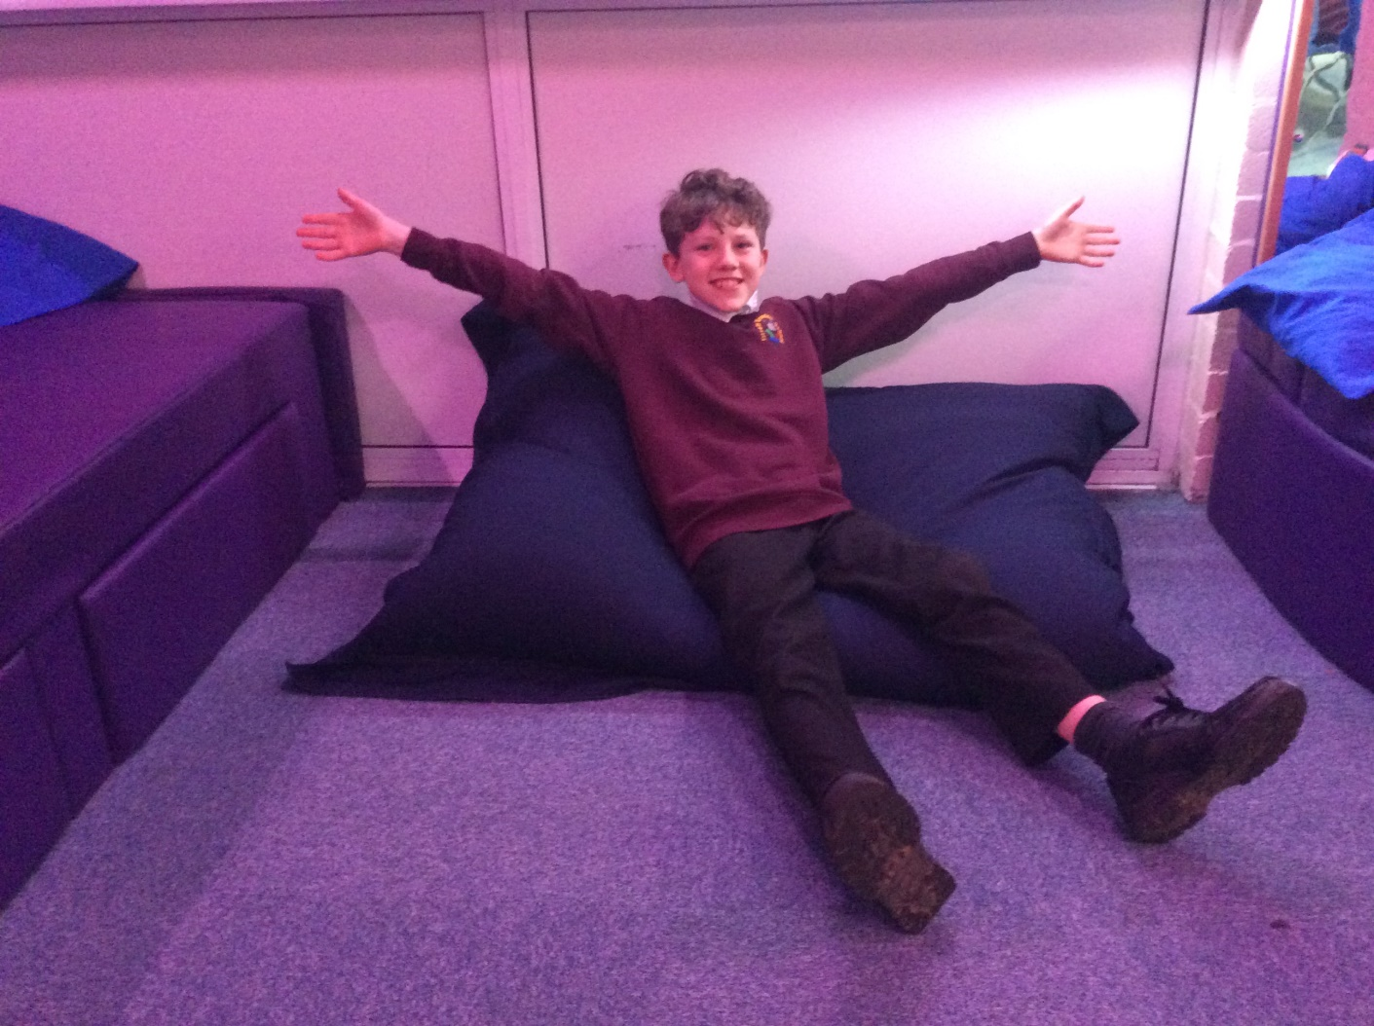
Bean Bags for the Sensory Rooms

Slide 4
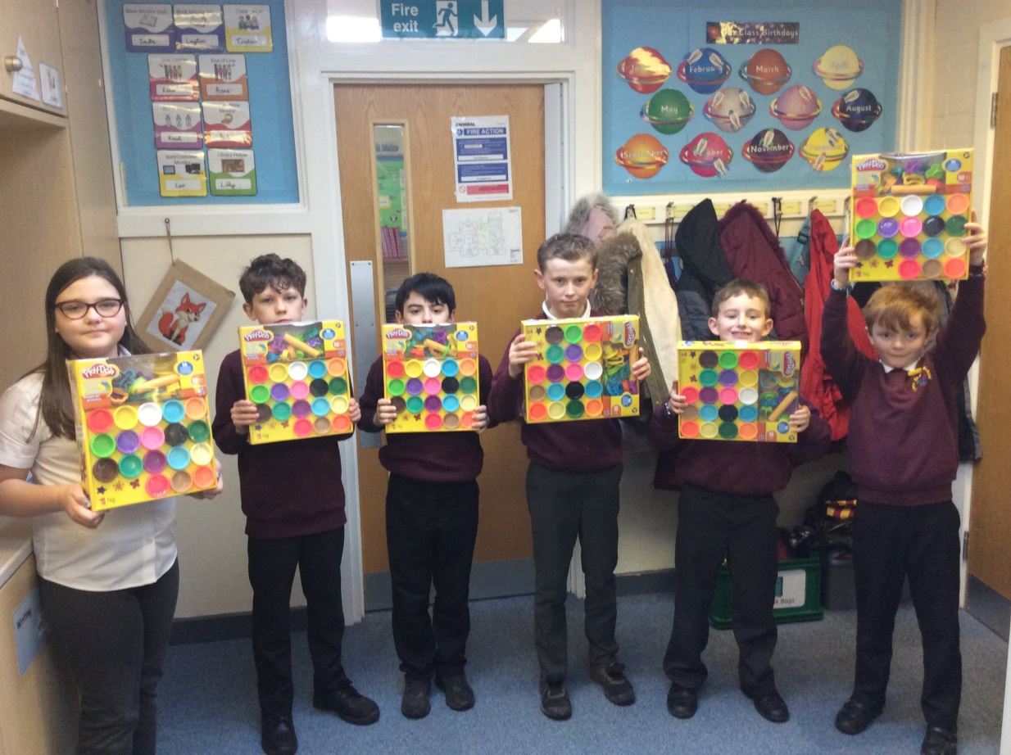
Play Doh!

Slide 5
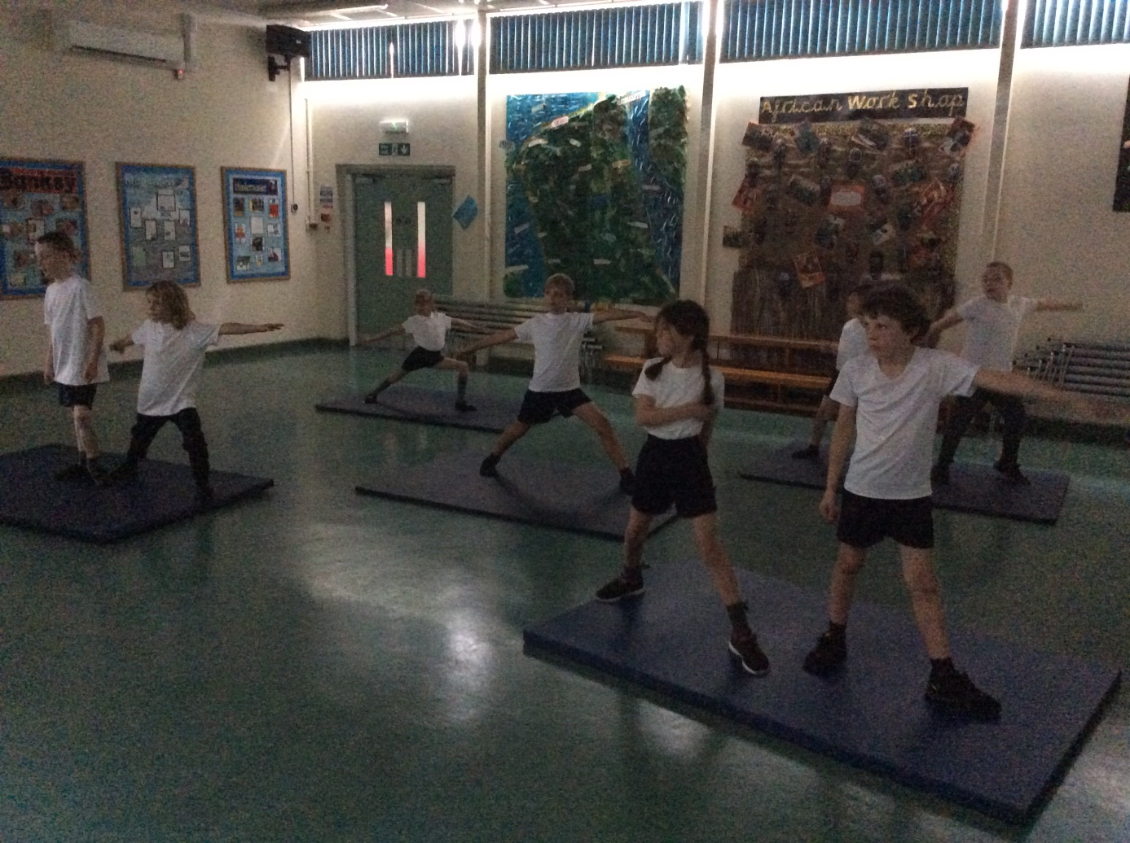
Yoga Mats

Slide 6
Skittles for the Playground

Slide 7
Brand New Sandbox

Slide 8

Pyjama Day

Slide 9
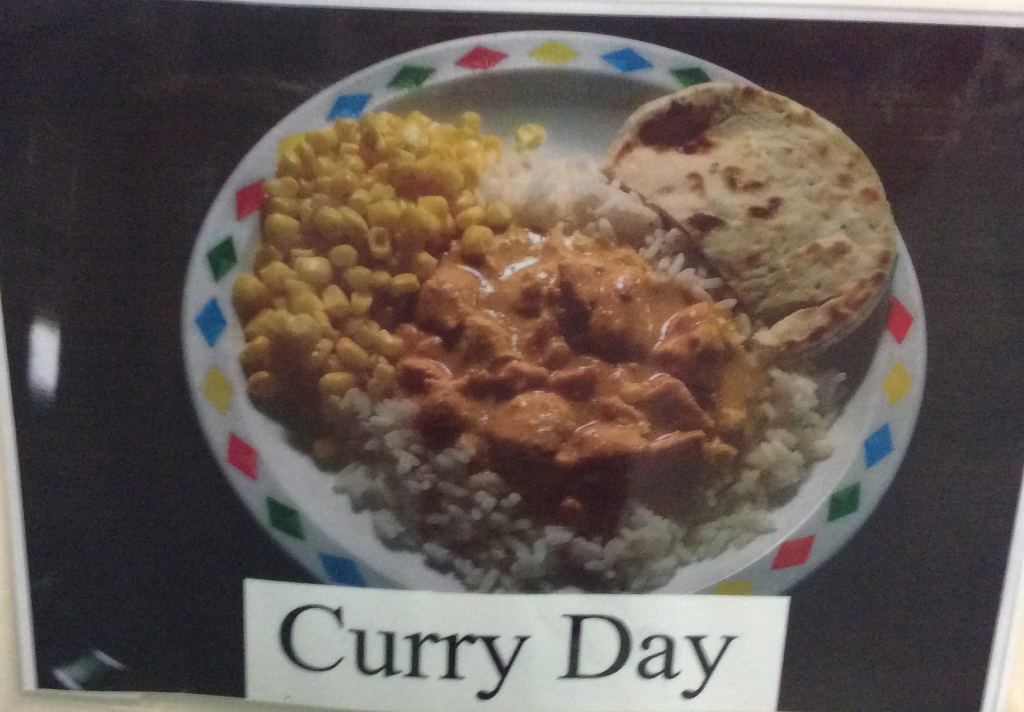
Curry Day

Slide 10
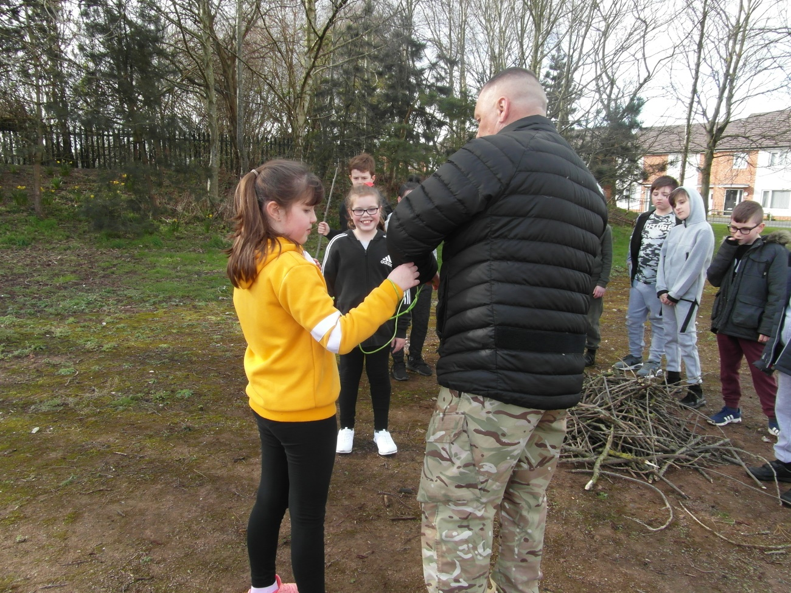
Military Education

