Slide 1
Parents Reading Coffee Morning 2020
Matthew Ferris
(English Lead)

Slide 2
Agenda
Understanding learning difficulties
The skills needed for reading
Reading at Orrets Meadow
Reading tips
Bug Club

Slide 3
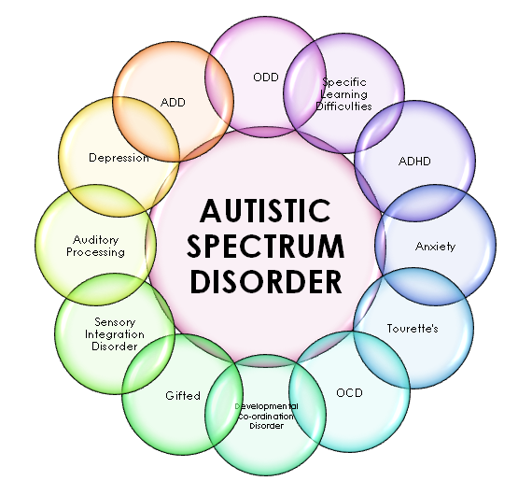
Autistic
Spectrum
Condition

Slide 4
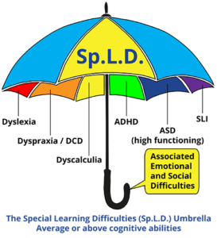
What are Specific Learning Difficulties (SpLD)?

Slide 5
Some common characteristics of SpLD:
Memory difficulties
Organisational difficulties
Writing difficulties
Visual processing difficulties
Reading difficulties
Auditory processing difficulties
Time management difficulties
Sensory distraction: an inability to screen out extraneous visual or auditory stimuli
Sensory overload: a heightened sensitivity to visual stimuli and sound; an inability to cope with busy environments

Slide 6
Dyslexia
Many people who have dyslexia have strong visual, creative and problem solving skills.
Dyslexia is not linked to intelligence but can make learning difficult.
Dyslexia is a life-long condition which has a substantial effect on an individual’s day to day activities and is classed as a disability under the Equality Act 2010.
Dyslexia varies from person to person and no two people will have the same set of strengths and weaknesses.

Slide 7
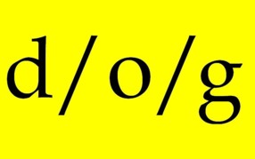
Phonological Deficit Theory
The theory that dyslexics have difficulty hearing and using the smaller unit of sound that make up reading, writing and spelling.
Notes:
The phonological deficit hypothesis is a prevalent cognitive-level explanation for the cause of reading difficulties and dyslexia. It stems from evidence that individuals with dyslexia tend to do poorly on tests which measure their ability to decode nonsense words using conventional phonetic rules, and that there is a high correlation between difficulties in connecting the sounds of language to letters and reading delays or failure in children.^{[1]}
The basic hypothesis is that reading failure or dyslexia stems from a functional or structural deficit in left hemispheric brain areas associated with processing the sounds of language. Some researchers have studied the structure and function of neural pathways in the language areas of the brain. Others have focused on the perception of short or rapidly varying sounds of language, positing that the core deficit is one of timing rather than of overall function.^{[2]}
In the past two decades, the phonological deficit hypothesis has been the dominant explanation favored by researchers as to the probable cause of dyslexia, but it is only one of several competing theories. Critics of the phonological hypothesis point out that it fails to account for symptoms of dyslexia unrelated to phonetic decoding difficulties, such as problems with short-term memory, visual processing issues, or difficulties with balance and small motor coordination that are common to many dyslexic children and adults. They also argue that much of the evidence for the theory is based on circular reasoning, in that phonological weakness is seen as both a defining symptom of dyslexia and as its underlying cause.

Slide 8
Poor Working Memory
Working memory helps children hold on to information long enough to use it.
Working memory plays an important role in concentration and in following instructions.
Weak working memory skills can affect learning in many different areas across the curriculum.
Auditory
Memory
Visual-Spatial
Memory

Slide 9
Developing Auditory Memory
Verbal rehearsal-repeating vocally or sub-vocally.
Elaborative rehearsal-linking to prior knowledge
Chunking- grouping information.
Relational Strategies-giving meaning (Imagery, mnemonics, rhyme)
Notes:
Verbal Rehearsal – repeating words or numbers, either vocally or subvocally
(e.g., Try saying the numbers over and over, like this: 2, 7, 5; 2, 7, 5; 2, 7, 5.);
• Elaborative Rehearsal – associating new information with prior
knowledge, such as creating sentences of the to-be-remembered word
or creating a story, or paraphrasing [reorganizing larger amounts of
information into smaller, more personally meaningful units (Donahue
& Pidek, 1993)];
• Chunking – pairing, clustering, grouping, or association of different items into larger
units (e.g., Try putting the numbers together. So if you hear 2, 4, 8, 3—think 24, 83.);
• Relational Strategies – making the information being memorized more meaningful
through mnemonics, imagery, or elaboration (e.g., Try to make a simple sentence
using the words you hear. If you hear dog, hat, bed, make a silly sentence like, “The
dog found a hat under the bed.”).

Slide 10
Developing Visual-Spatial Memory
Copying patterns-tracing and repeating letters and words.
Sequencing- flashcards, alphabet letters, toys
Visual Prompts- on the desk or kept with them.
Memory games- I spy, What’s the difference, I went to market ect
Pellmanism- tray of items and hide an object.

Slide 11
The skills needed for reading

Slide 12
What skills are required to be an effective reader?

Slide 13
Reading Fluency

Slide 14
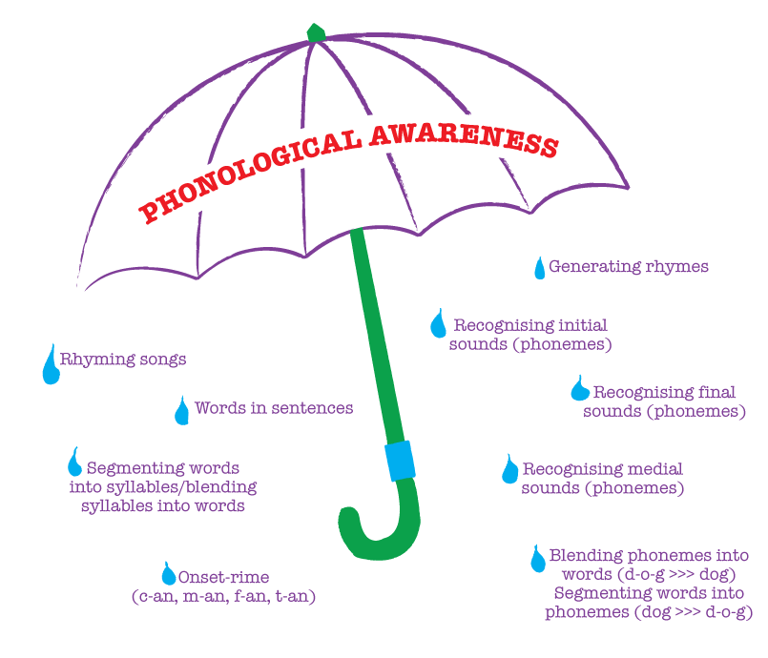
Phonological Awareness

Slide 15
Reading at Orrets Meadow

Slide 16
Core Curriculum
Spelling (30 mins) Basic Skills including spelling and reading of Key Words and phonics.
English (1 hour) Reading comprehension, speaking and listening, and writing in a variety of genre.

Slide 17
Orrets Meadow Literacy Spine
Available on the website.
Split into curriculum texts and class readers.
Books for different purposes - learning and pleasure.
Class readers to promote Prosody

Slide 18
PROBES
Sight read
Fluency
Confidence
Expression
Comprehension
How do they work?
Develop a bank of words children can ‘sight read’
This in turn helps with fluency and also confidence.
With fluency children can develop expression and comprehension of the text.

Slide 19
PROBES
How do we choose PROBES?
Children are assessed termly on Orrets Meadow Phonic steps.
Generates an individual list of probes for the children improve their reading.
Types of PROBE:
Phonic = One of 44 sounds that are part of words in the English Language.
Keyword = commonest words in the English Language, not all of which fit a spelling rule.

Slide 20
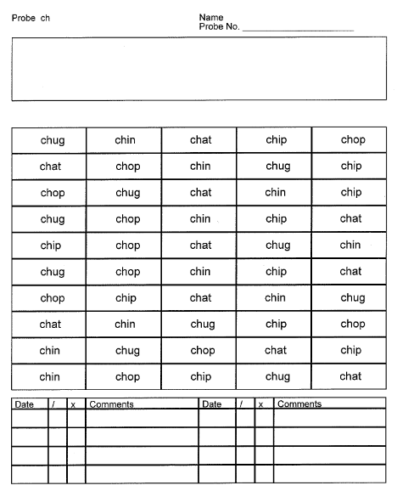

Slide 21
How to read a PROBE
Ask what type of probe it is. (Keyword or sound, expect child to know the sound remind them if they don’t.)
Always read left to right.
Target: All 50 words in less than a minute.
Read a few lines
Play word games, if the child is overwhelmed.

Slide 22
Reading books
This year book bands have been introduced.
These are roughly levelled and act as a guide for staff.
There is a big range within each level.
Every reading journey is different.

Slide 23
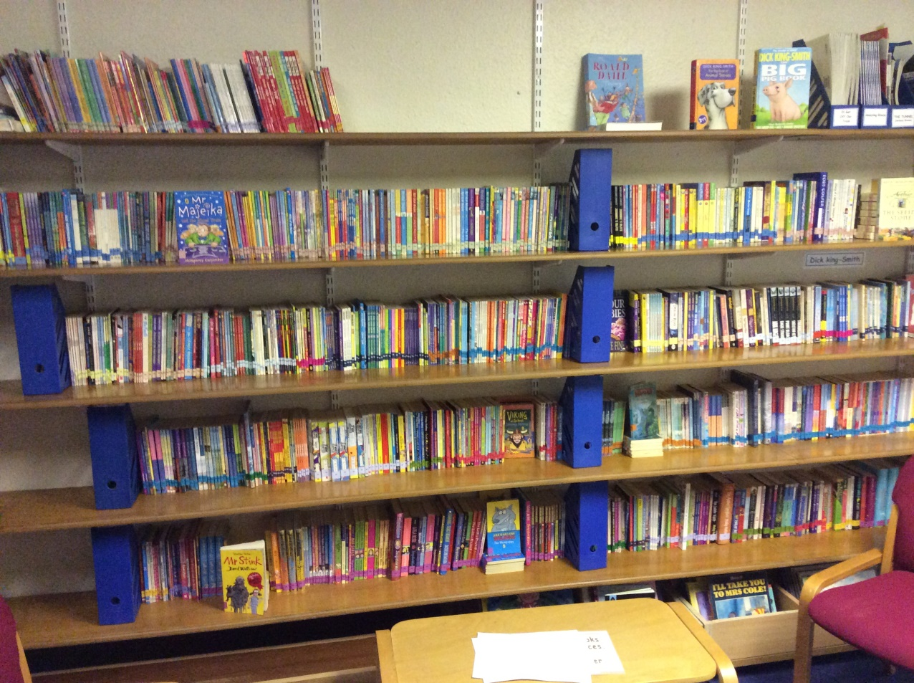
The Library
Books are being sorted and updated.
Aimed at promoting reading for pleasure.

Slide 24
Reading with your child

Slide 25
Types of reading you could try
Sharing a story
Exploring pictures
Share reading
Audiobooks
Your child reading to you

Slide 26
Tips for Reading with your child
Routine, same time and same place.
Find somewhere tidy and quiet. (No TV, radio or music, clear the surfaces)
Sit together, side by side or 90° angle.
Expect the child to hold the book or probe.
Read PROBE first.
Always read left to right.
New PROBES: ask them to point at specific words, share reading a line or two lines each ect
Familiar PROBE: Time your child and encourage them to beat their last score.

Slide 27
Tips continued…
Ask questions before your child reads their book.
What does your child remember?
What is the theme?
What will happen next? etc..
Read aloud everyday.
Model reading- let them hear you read.
Ask questions at the end.
How are characters feeling?
Why did they do that?
Who would you recommend the book too? etc.

Slide 28
Showing sounds in a word
Sometimes our children are unsure where to start with a word, especially those beginning to read or attempting more complex words.
You can use ‘sound buttons’ to show them the sounds in a word.
shut light

Slide 29
Reading homework
We have a great variety of reading books from many different authors and publishers.
Children will read daily in school with a TA or a Teacher.
Early readers will re-read pages or a book from school for homework, to build confidence and fluency. This acts as another opportunity to overlearn sight words and phonics.
Later on children will read the next section or chapter in a book.
Reading books and schemes are changed regularly.
Children should be expected to answer questions about what they read at all levels of reading.
Notes:
4,458 individual titles!
5 Decades of publications
Over 30 different reading schemes

Slide 30
Reading outside of homework
Environmental print (street names, shop names, labels, games, internet etc.)
Following recipes
Join a library
Read to a little brother, sister or pet.
Read a magazine together.
You are never too old to read picture books!
Research a topic on the internet together.
Word games e.g. I spy a word ending with /tch/

Slide 31
Praise and Encouragement
Remain positive
Celebrate small steps (A few more words on a probe, blending and sounding out a new word in their reading book etc.)
Offer or negotiate rewards -stickers, activities, computer time etc.

Slide 32
Bug Club
Pupils use Bug Club at least once a week in school.
It is a familiar platform for your child to explore books.
There are games on it that help to promote reading.
It also follows book bands similar to those in school.
It asks appropriate a relevant questions as your child reads.

Slide 33
Benefits of reading:
Builds their relationship with you
Improves basic speech patterns
Develops communication skills
Encourages logical thinking
Emotional intelligence
Improves concentration
Allows access to wider knowledge
Independence

Slide 34
Please communicate
Reading Record Book
Pleased sign and comment every day-Teacher and TA’s read the comments and can reinforce and support your comments or address any issues.
Thank you for all your support!

Slide 35
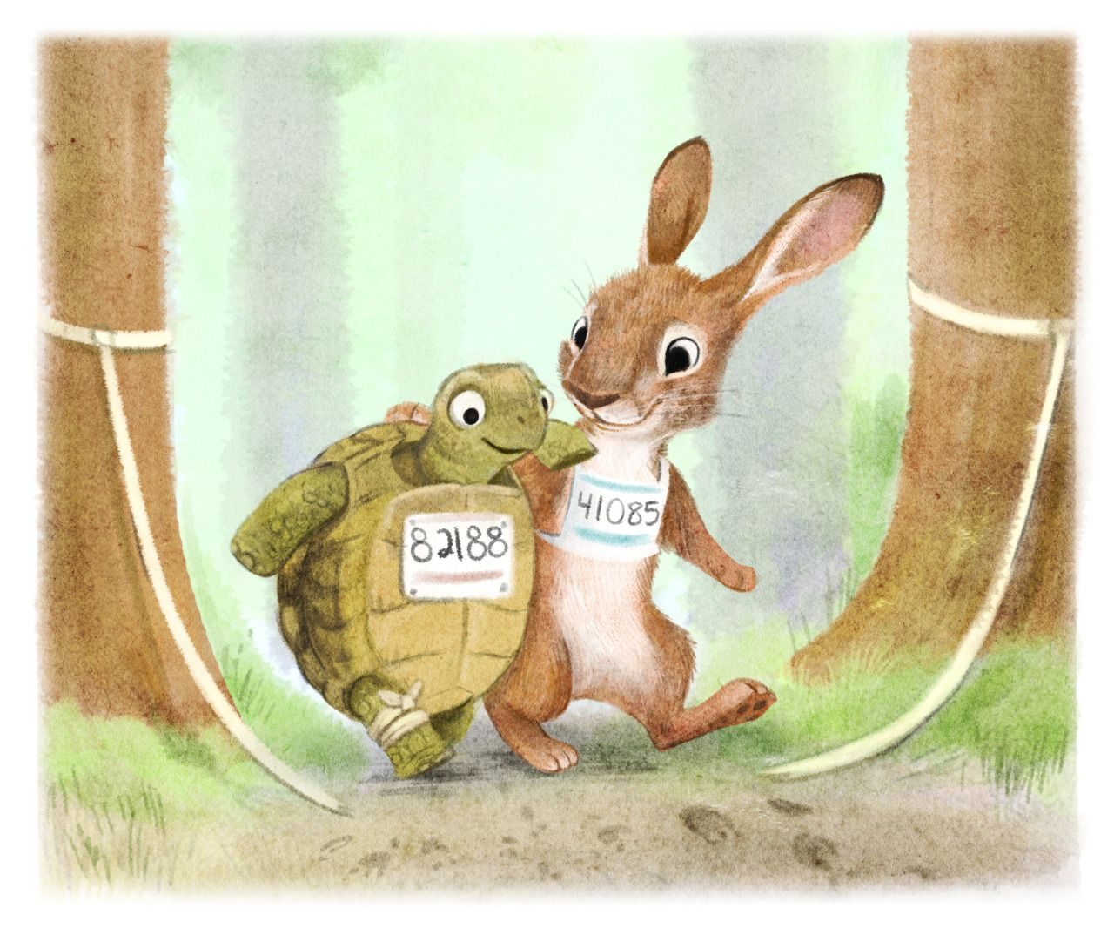
Remember it’s not a race!

