Slide 1
Introduction to Sensory Processing

Slide 2
Functions of Behaviour
All behaviour is functional in some way. Common functions may include:
Gaining of attention / communication
Escape or avoidance.
Gaining of preferred activities or objects (Tangible).
Sensory needs.
PLEASE CONSIDER THAT FOR SOME YOUNG PEOPLE THEY END UP ENGAGING WITH A SENSORY RELATED BEHAVIOUR….BUT….IT WAS ACTUALLY CAUSED BY A DIFFERENT FUNCTION

Slide 3
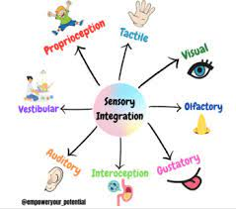
We have 8 senses!
Vision
Auditory
Tactile
Olfactory
Gustatory
Proprioception
Vestibular
Interoception
Sight
Hearing
Touch
Smell
Taste
Input from muscles / joints
Head movement and balance
Feelings and internal state

Slide 4
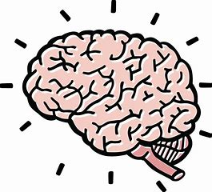
What is Sensory Processing Disorder?
ORGANISE
RECEIVE
RESPOND
Learn
Attend
Body Awareness
Express feelings
Self control / esteem
Co-ordination
Self esteem
Demonstrate knowledge
Interaction
Independence Skills
Communication
Sensory Input
(11 million pieces !!)

Slide 5
Filtering out
The human brain can process 11 million bits of sensory information every second BUT our conscious minds can handle only 40 to 50 bits of information a second (70-80 max).
This process is known as filtering out.
Some people’s brains struggle to do this effectively and either let too much information through or filter the wrong information out. This can lead to sensory overload, under responsiveness and sensitivities, which can result in a range of difficulties,

Slide 6
Associated diagnosis
Autism (prevalence is estimated to be as high as 80% to 100%)
Complex learning difficulties.
ADD / ADHD.
MENTAL HEALTH - Anxiety / depression / OCD / Attachment difficulties
Childhood trauma / abuse
Foetal alcohol syndrome.
Varying Genetic Conditions.
Premature babies / reduced tummy time / birth history.
Visual / hearing impairment

Slide 7
Sensory Modulation
The ability to process and organise the quality and speed of a reaction to sensory stimuli, to filter irrelevant stimuli, and to maintain a level of attention necessary for optimal functioning.
It is a continuous ongoing process.
Normally, healthy sensory modulation is an automatic, unconscious process, which in children developing normally occurs without effort. However, for those children with a range of developmental problems, sensory modulation is ineffective, requiring effort and concentration with no assurance of accuracy.
A child with modulation difficulties may over respond or under respond to sensory stimuli.
Example:
These children do not know when to stop and how to stop. They will keep seeking and going and going.
Someone may bump into them and they will react as though they have broken their arm.
They may have an “outburst” for no apparent reason.
They are “up and down”.
They will over or under respond to certain types of sensory stimulation.

Slide 8
Visual
Receptors are in our eyes!
Our receptors recruit information from the environment about light, colour, movement, shape
The receptors then send this information to the brain!
The brain will organise this information and then process it
The brain will send signals back to the body to respond to the information that it has received

Slide 9
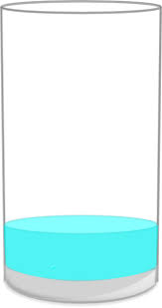
Visual under-responsiveness
The receptors in the eye send ACCURATE information to the brain
The brain may then not be able to process the information accurately as it is not sensitive enough to detect it
In order for the brain to process the information it needs MORE of it to detect it
In order to recruit enough visual input, the young person will SEEK out more of it throughout their day to allow the brain to detect and process it accurately
What might we see?
Waving hands in front of eyes | Difficulty copying
Waving objects close to eyes | Makes reversals in words / letters
Watching the swing | Moving head side to side
Difficulty following and tracking items with eyes | Looking closely at lights or flickering lights

Slide 10
Visual over-responsiveness
The receptors in the eye send ACCURATE information to the brain
The brain is very sensitive to this sensory input and may struggle to screen out irrelevant background input and only needs a little bit of it to process it
If lots of this input is recruited, then this sensory system may “overflow” and the brain cannot cope with, sort and process the amount of input that is receives
The young person may AVOID excessive visual input or may become distressed in busy environments
The young person may need a sensory break in a space with low levels of visual distractions so that they can process the input that they have already recruited
What might we see?
Dislikes busy environments | Focus on an object to help with screening out background visuals
Very easily distracted | Avoids bright lights / covers eyes / squints
Struggles to concentrate in busy classrooms | Avoids excessive movement Fight / flight

Slide 11
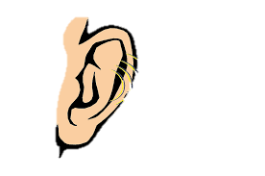
Auditory
Receptors are in our ears!
Our receptors pick up information from the environment about noise, volume, pitch and language
The receptors then send this information to the brain!
The brain will organise this information and then process it
The brain will send signals back to the body to respond to the information that it has received

Slide 12
Auditory under-responsiveness
The receptors in the ears send ACCURATE information to the brain
The brain may then not be able to process the information accurately as it is not sensitive enough to detect it
In order for the brain to process the information it needs MORE of it to detect it
In order to recruit enough auditory input, the young person will SEEK out more of it throughout their day to allow the brain to detect and process it accurately
What might we see?
Difficulty identifying where a noise came from | Making their own noises
Difficulty identifying who has spoken | Speaks loudly
Listening closely to objects that make a noise | Doesn’t always respond to name being called
Settled in noisy environments | Speech delay

Slide 13
Auditory over-responsiveness
The receptors in the ears send ACCURATE information to the brain
The brain is very sensitive to this sensory input and so picks up every noise in the environment
If lots of this input is recruited, then this sensory system may “overflow” and the brain cannot cope with, sort and process the amount of input that is receives
The young person may AVOID noisy environments or may become distressed when they hear a loud noise
The young person may need a sensory break in a space with low levels of visual and auditory distractions so that they can process the input that they have already recruited
What might we see?
Covering their ears with hands | Over – react to some noises
Distressed in noisy environments | Clapping near ear when background noise increases
Difficult to concentrate in noisy environments | Makes own noises to help screen out background noise. Volume may increase with volume of background noise

Slide 14
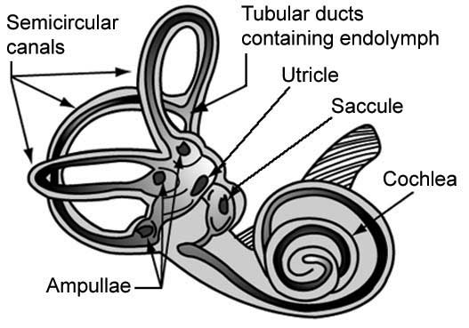
Vestibular
It is located in our inner ear.
Movement detection system that informs us about movement of our head and body against gravity.
Balance, spatial orientation and maintaining a stable visual image even in motion.
Attention and arousal levels (sleep / wake cycles).

Slide 15
Vestibular
Seeking more
Avoiding
Over responsive
Under responsive
Under sensitive
Over sensitive

Slide 16
Under-Responsive Vestibular
Excessive spinning, watching things spin. Flapping in front of eyes.
Doesn’t get dizzy with spinning.
Excessive movement: Climbing, jumping and pacing / bouncing / running
Difficulty sitting still / ROCKING IN CHAIR.
Reduced attention.
Lacks insight to safety.
YouTube (fast and repetitive movements).
Has to move body to be able to listen.
Head upside down.
Shaking head.
Tilts head and looks out of corner of eyes
Swings
Flexed posture

Slide 17
Over-Responsive Vestibular
Dislikes trikes / bikes .
Holds on to things when walking, including adults, walls, hand rails, etc / Resistant to transitions
Difficulties coming downstairs.
Dislikes head tilting backwards (washing hair in bath / lying down to be changed).
Car / travel sick.
Avoids theme park rides
Poor balance.
Difficulty walking on uneven surfaces.
Cautious and hesitant with movement.
Avoids lifts / escalators
Anxious when not in control of own movements
Prefers sedentary engagement / being grounded sat / lead down on the floor.

Slide 18
Proprioceptive
Messages from muscles and joints - where we are in space and how body parts relate to one another.
Amount of force being exerted.
Rate, timing and sequencing of movements.
Muscle contraction / tension.
Body position.
Helps the brain regulate arousal levels.
Helps inhibit other sensations.
THIS IS THE SECRET STRATEGY!!!

Slide 19
Under-Responsive Proprioceptive System
Floppy and weak muscles.
Heavy handed / heavy footed
Clumsy
Seeks crashes, bashes, climbing, bumping and firm cuddles / tickles.
Toe walking (also vestibular).
Struggles to sit / stand still (also vestibular)
Leans into people / objects / pulls down against adult
Hand flapping / clapping.
Opens mouth wide
Dropping to the floor / banging body on the floor.
Throwing objects
Climbing
Chewing
Pushing ears or eyes
Pushing / rubbing genital area

Slide 20
Self Injurious Behaviours
Head banging (sometimes targeting specific areas on head that has bruised / broken down / knee to head).
Picking skin.
Pulling own hair out.
Pushing fingers in eyes / ears
Biting self (targeting specific areas on hand that have already broken down).
Hitting self (inc punching specific areas, trying to knock own teeth out, head to knee action)

Slide 21
Tactile
Skin is the largest most sensitive organ.
This system registers light touch, pain and temperature and aims to protect us.
The most sensitive areas are on the palms of the hands/ soles of the feet and around the oral area
This system enables us:
To work out where and how are bodies are positioned.
Object information.
To develop fine motor skills (including hand writing).

Slide 22
Tactile
Over responsive
Under responsive

Slide 23
Under-Responsive Tactile System
Lack of awareness of messy hands or face.
Loves “messy” activities of engagement / use mealtimes as messy play activity if given the opportunity
Constantly touching things.
Fidgeting.
Difficulties lining up (touching everyone).
Inappropriate touch (skins, hair, etc).
Unaware of when clothing is twisted.

Slide 24
Over-Responsive Tactile System
Avoids mess / being dirty and may regularly / immediately request hand washing / wiping / avoids touching certain foods.
Struggles with shoes / socks / clothing / coats
Difficulties tolerating washing / brushing / cutting of hair, nails and teeth.
Puberty (physical changes)
Withdraws from cuddles / avoids holding hands.
Struggles in crowded environments.
Difficulties lining up or being close to others.
May insist on carrying favoured item, or collects items to carry during the day.
May walk on tiptoes on certain surfaces.
Does not like rain / wind.

Slide 25
Over-Responsive Oral Tactile System
Dislikes tooth brushing.
Gags easily.
Fussy eater.
It’s more than just
“Fussy eating, or the beige diet, or just eats carb’s”.

Slide 26
Under-Responsive Oral Tactile System
Drools.
Objects in mouth (may be specific types of substances).
Chewing on clothing.
Over filling mouth.
Spitting.
Poor articulation / speech.
Grinds teeth.
Bites (this can sometimes be communication).

Slide 27
Making sense of sensory difficulties

Slide 28
What is the 8th Sense:
Interoception

Slide 29
Interoceptive
Gives us the ability to FEEL what is happening inside our body.
Purpose of this system is to help our bodies stay in a state of optimal balance (homeostasis):
Hunger.
Thirst.
Pain.
Temperature.
Fatigue.
Bladder / bowels.
Rubs genital area
Also responsible for allowing us to feel our emotions.

Slide 31
Sensory overload
Lots of children, particularly those who have autism experience sensory overload
What is this?????
Sensory overload is when your senses take in more information than your brain can process!
When your brain is overwhelmed by this input, it enters fight, flight, or freeze mode in response to what feels like a crisis.
This can make the person feel irritated, loss of control, unsafe or even panicky.
After a period of dysregulation, many individuals express that they feel a sense of guilt or embarrassment.

Slide 32
Can you make it to the end? NAS

Slide 34
How can we support this?

Slide 35
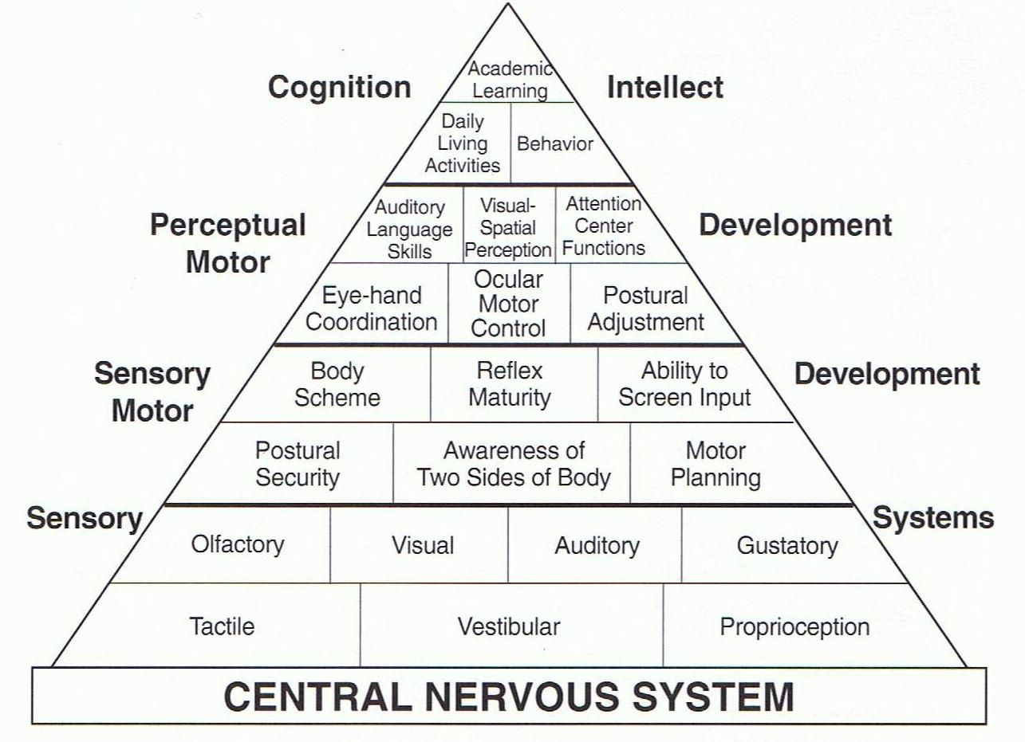

Slide 36
Identify
Look out for any clusters of behaviours which might indicate a sensory processing challenge.
Speak to your child about what situations they find difficult.
Speak with teachers to see if there is anything happening at school which might indicate a sensory processing problem.
May need a referral to OT to help with identifying need.

Slide 37
Consider the environment
Noise
Fluorescent lighting
Clutter in the room
Are there adequate provisions available?
Are electrical items switched off?
What is the temperature like?
Is furniture the right height?
Smells in the room
Clothing

Slide 38
Consider the task
What are the expectations of the task?
Do they need to sit still for a long time?
Does the task provide the just right challenge? – motor skills in particular
Are they expected to feel unfavourable materials?
Have they just had a movement break?
Consider their level of alertness
Is the task motivating?

Slide 39
Movement breaks
Movement breaks can be targeted differently dependant on the child’s needs!
Natural breaks incorporated into their day OR more specific high level sensory breaks (i.e. that need adult scaffolding).

Slide 40
Introduce graded motor tasks
Start off with something that they can already do
Build it up to make it more difficult
Bilateral integration (using 2 sides of the body)
Strength (core, shoulder)
Endurance
Hand eye, foot eye
Grading of force
Balance
Body awareness
Sequencing
Copying off modelled movements
Rhythm

Slide 41
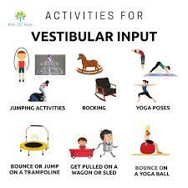
Vestibular activities (movement)
Always follow with proprioception

Slide 42
Proprioceptive strategies (calming)

Slide 43
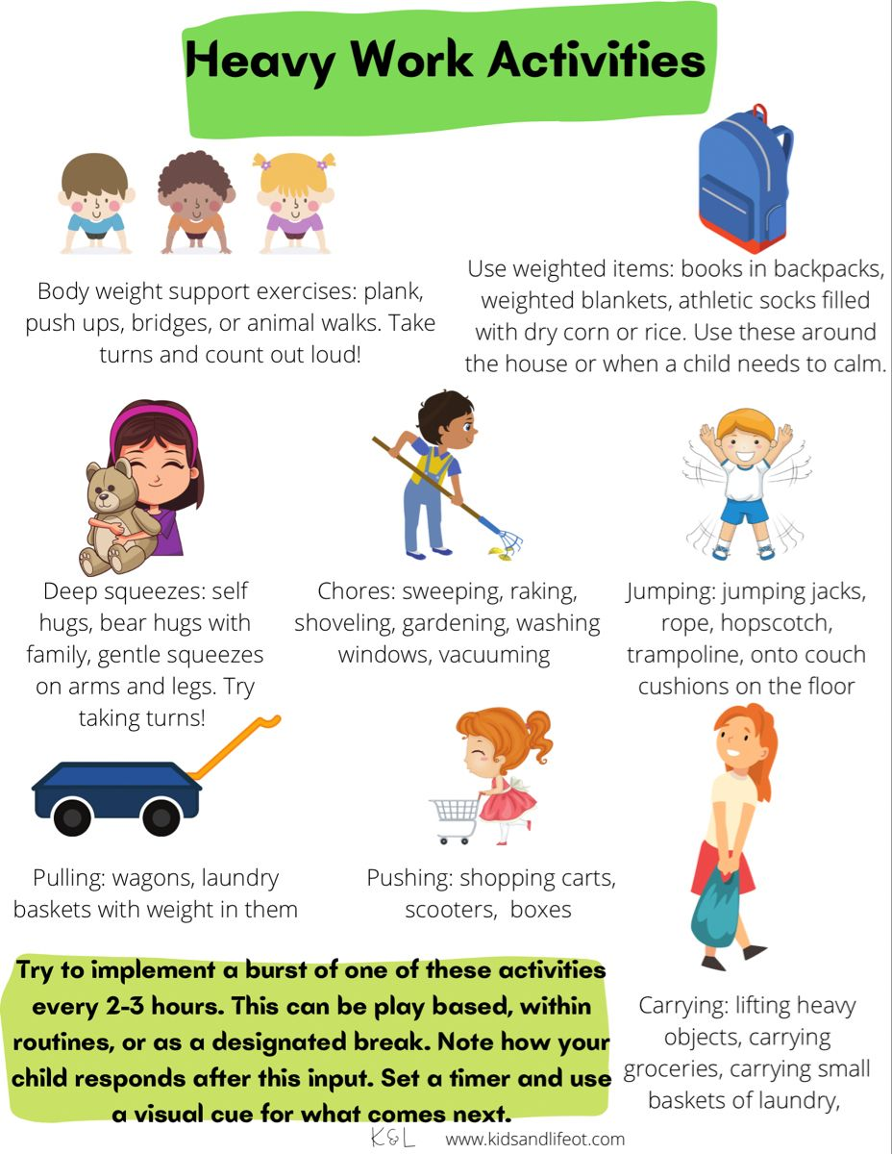

Slide 44
Any Questions?

