Slide 1
Maths Parent support group
Calculation policy
Mrs Billington

Slide 2
Welcome
Objectives for this meeting.
To introduce parents and carers to a quick review of maths taught in school today and show a range of teaching strategies used for working out maths number problems.
To discuss dyslexia and maths.
To discuss dyscalculia and maths.
To discuss ASC and maths.
To give helpful ideas and suggestions to help your child at home with number work.

Slide 3
Contents
Questions
Maths subjects
Learning Objectives
Learning Difficulties
School calculation Policy
Resources
Real life Maths
Questions

Slide 4
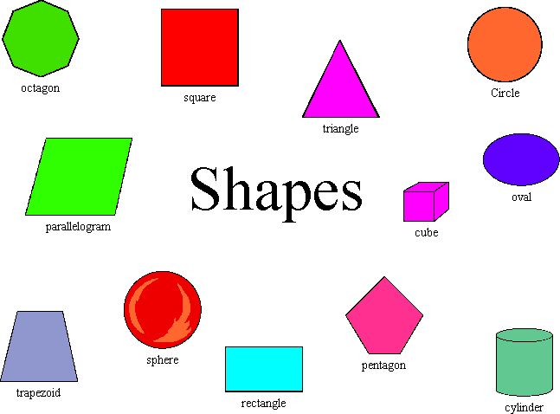
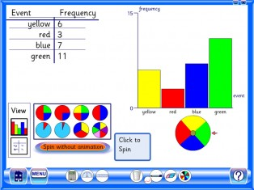
Maths subjects
Within school we aim to give a broad coverage of topics:
Number and the number system
Shape space and measure
Data Handling
Using and applying

Slide 5
Number and the number system
Number bonds
Adding 1,2,3 etc subtracting 1,2,3
Adding several numbers
Number sequences
Multiples
X division + - Four operations

Slide 6
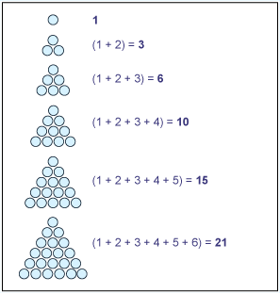
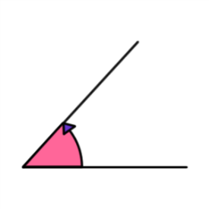
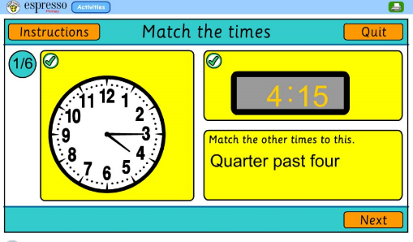
Shape and space
Knowledge and names of 2d and 3d shape.
Angles
Pattern
Area
Perimeter
Measure / Time

Slide 7
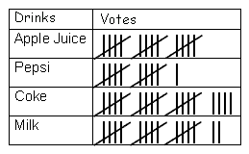
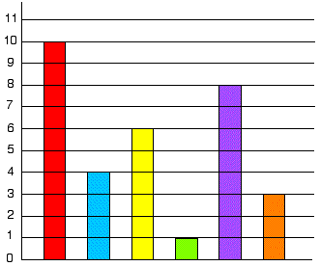
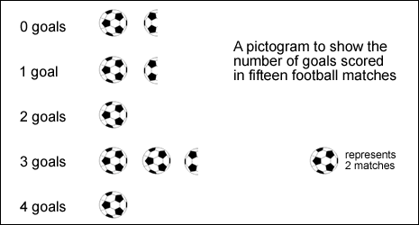
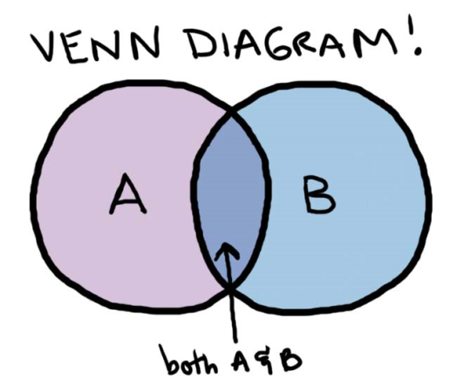
Data handling
Bar charts
Tally charts
Venn diagrams
Pictograms
Asking and answering questions about data.

Slide 8
Using and applying
Mental application
Questions
Written problems.
1,2,3, step problems using 1 or more operations.

Slide 9
Dyscalculia
For some children maths presents more of an issue. They lack the intrinsic understanding that a number is related to an amount.
They cannot see the abstract link between an amount and a symbol.
Children need a structured approach and lots of overlearning.
Strategies and pattern, visual aids and practical apparatus to help to construct number.

Slide 10
Dyslexia
For children with Dyslexia it can be very hard to work with number. Not all children have difficulties but quite often a short term working memory and difficulty organising data and ordering events can make it difficult to get the right answer.
Breaking down number problems into clear steps is the answer.

Slide 11
Autistic Spectrum Condition
Many students with ASD have an overall strength in recalling details. However, they may struggle with the synthesis of details or central coherence.
Central coherence is the ability to bring details together into a whole concept or idea.
Examples of weak central coherence include difficulties: 1. Integrating details into a concept.
2. Identifying a text’s main idea or concept.
3. Integrating pieces of information into a whole.
These difficulties might translate into difficulties with math word problems or concepts.

Slide 12
Learning Difficulties
Some of these learning difficulties can be effectively addressed, particularly with early interventions, and in some cases, these learning difficulties are also accompanied by strengths unique to autistic children and children with other Specific Learning difficulties (SPLD). Children with autism and other SPLD may be able to focus acutely on details but may lack the ability to pull back and see the big picture.

Slide 13
Learning Objectives
What do we need to know?

Slide 14
Maths STEPS

Slide 18
Key stage 1

Slide 21
Key stage 2

Slide 41
Order Visual

Slide 42
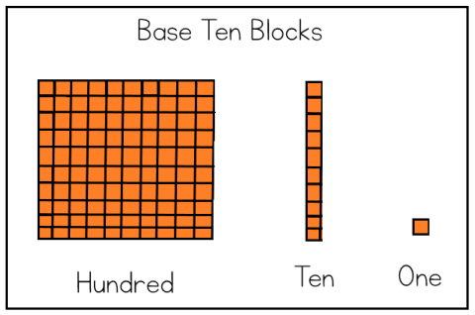
Base Ten

Slide 43
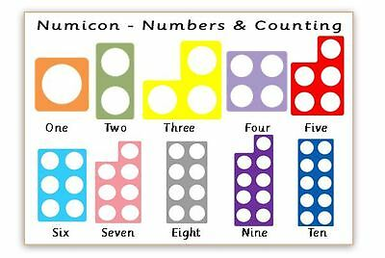
Numicon

Slide 44
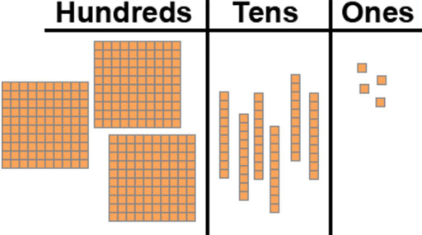
Base Ten

Slide 45
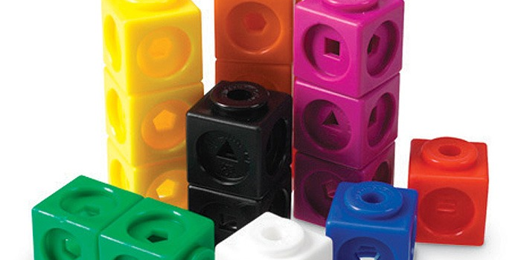
Cubes

Slide 46
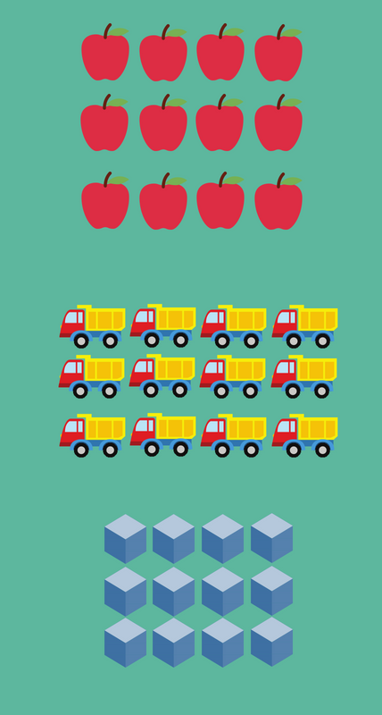
Number Array

Slide 47
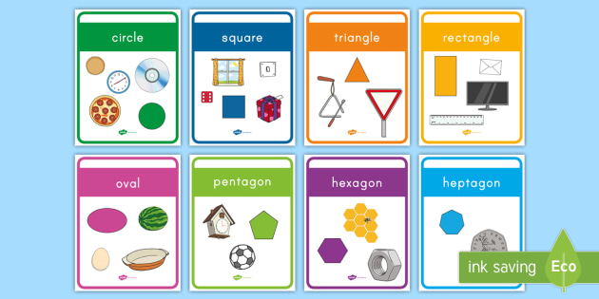
Real Life Maths

Slide 48
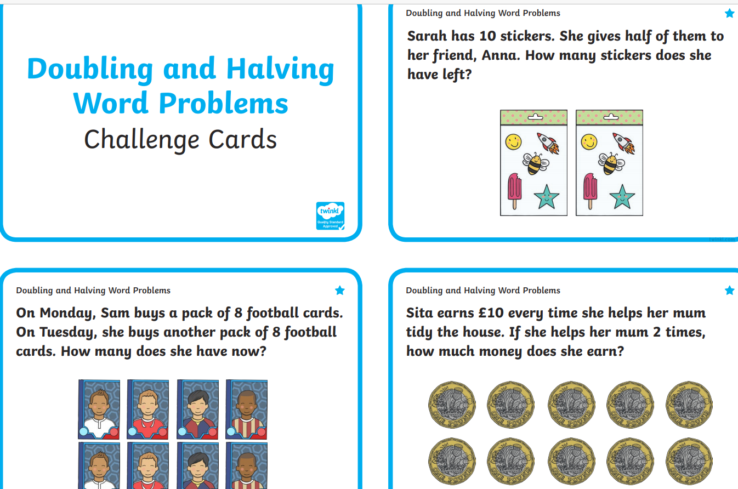
Real life problems

Slide 49
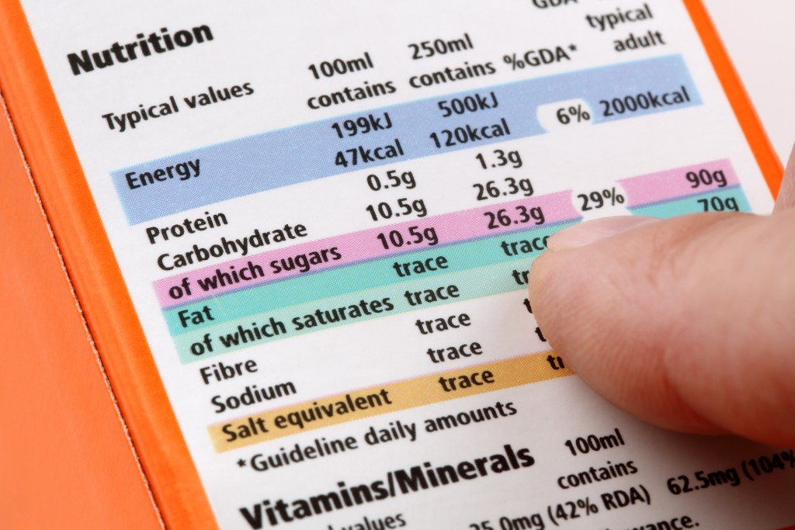
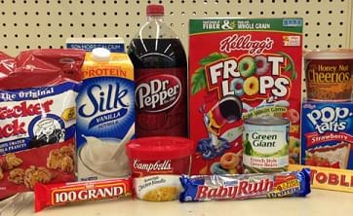
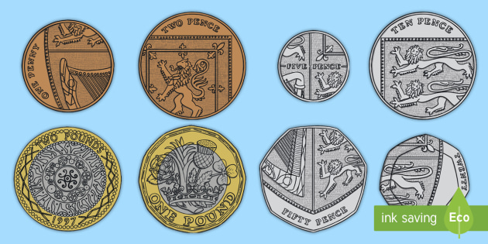
Real Life Maths
Look at products in your cupboards. Arrange them from lightest to heaviest.
Find the measurements on the packaging and discuss the different units of measure.
Keep milk bottles to measure out liquids
Use products in the cupboard to play shop.
Encourage the children to look at coins. Match what they are worth with cubes or pasta
E.g 5p = five cubes
Talk about change and how to work it out.
Measure cushion covers / curtains / rugs etc
Discuss how and why we would need to know these things.

Slide 50
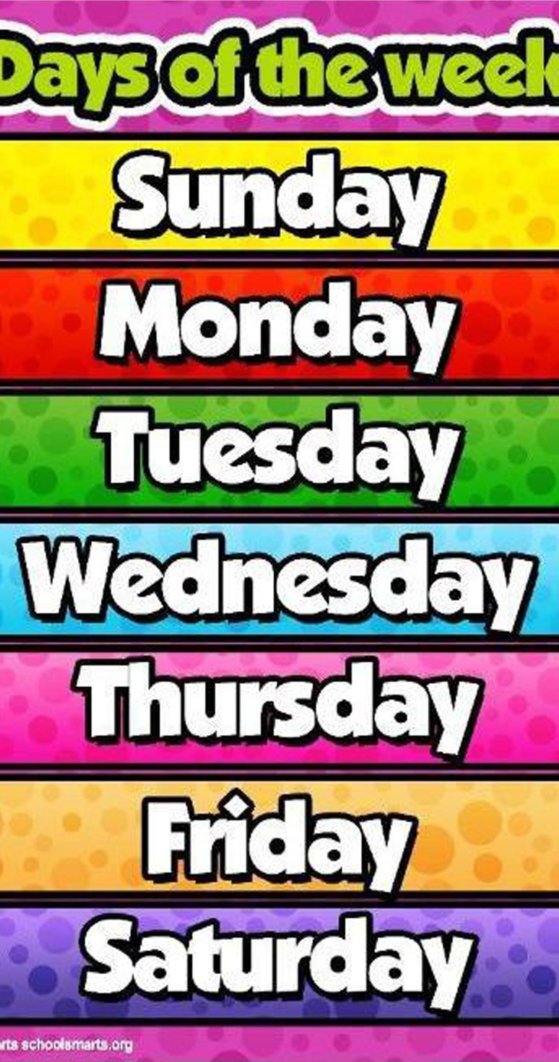
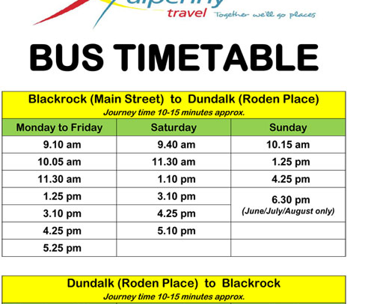
REAL LIFE MATHS
Make a daily timetable to order events.
Learn the days of the week
Months of a year
The number of days / months
Minutes in an hour
Seconds in a minute
Hours in a day
Look at timetables and work out journey times etc.

Slide 51
Thank you for attending.
Helpful websites:
BBC KS1 bitesize Maths
Mathletics
Education city
Top Marks Maths
Thanks again

